Slide 1
Sample SAP transactions
DEVELOPED FOR CURRENT EMPLOYER

Slide 2
API Sheet
For Purchasing department
A = arrivals (receipts), P = production (requirements), I = inventory
It uses either MRP (MD05) or current Requirements/Receipts (MD04) data
Allows various views (all receipts, only confirmed, already shipped out, none)
Allows simulations using manually entered data
Continous timeline or only columns containing some value
Fast CSV export (too big volume of data)

Slide 3
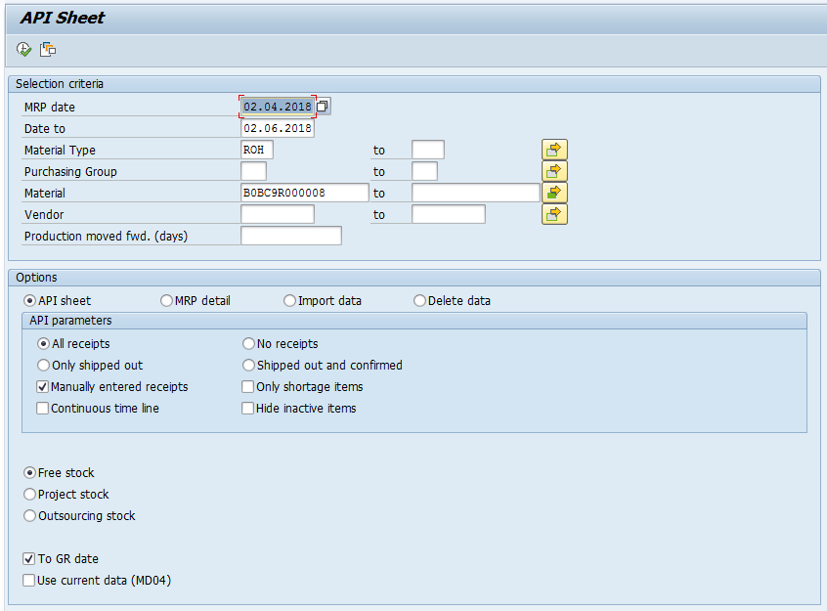

Slide 4
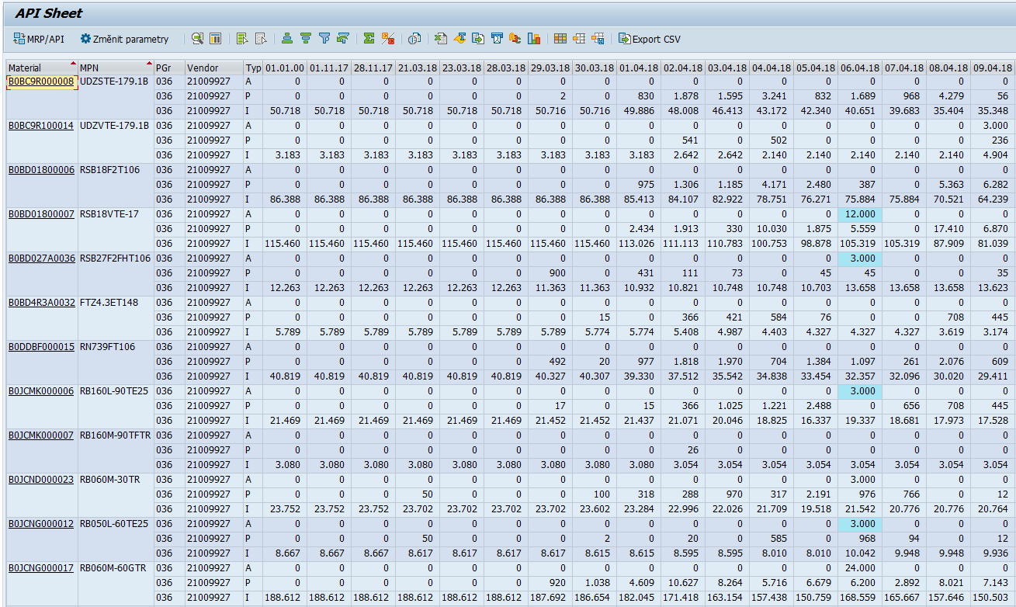

Slide 5
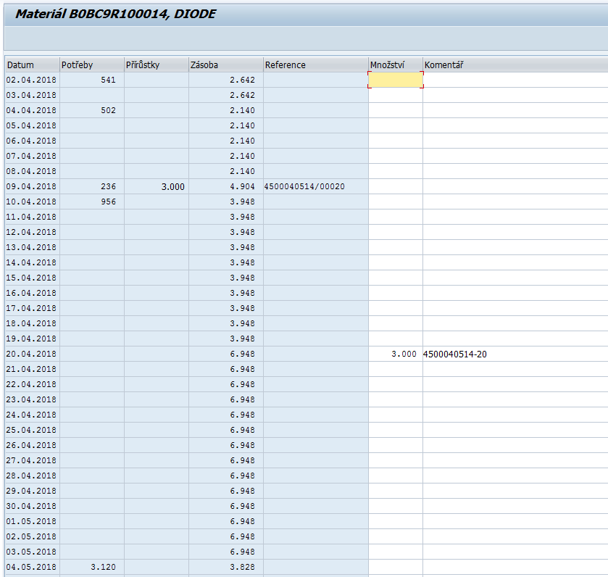

Slide 6
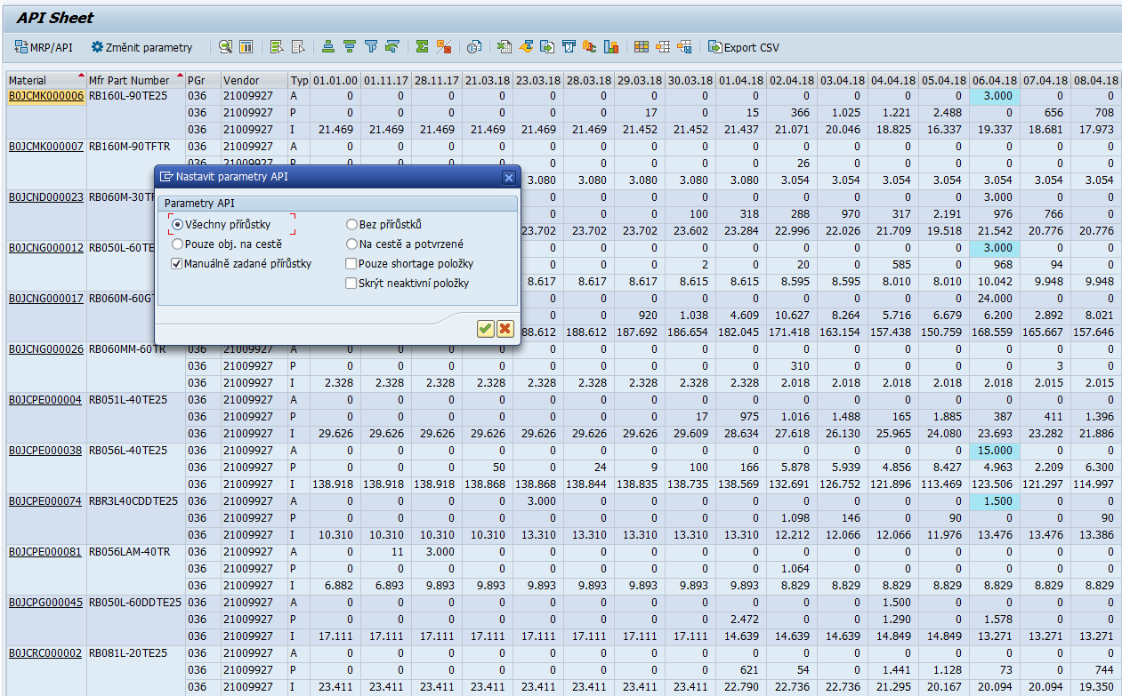

Slide 7
Database of IT Purchase orders
For purpose of IT department
Replaced non-suitable Excel database
It uses standard data of purchase orders (EKKO/EKPO tables)
Extended by some extra IT data (note, list of invoices, serial numbers, MAC addresses)
Allows to add attachment for each item (stored in customer cluster table)
Record to DB added automatilly when PO created
Notification sent to IT person

Slide 8
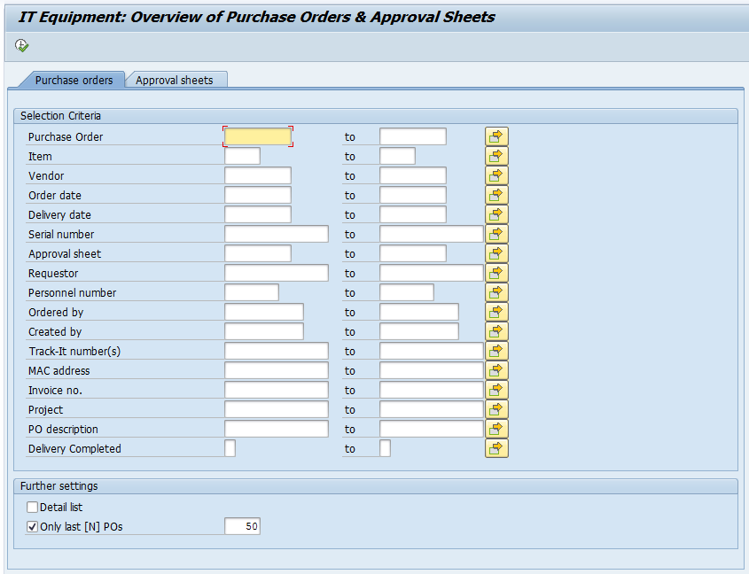

Slide 9
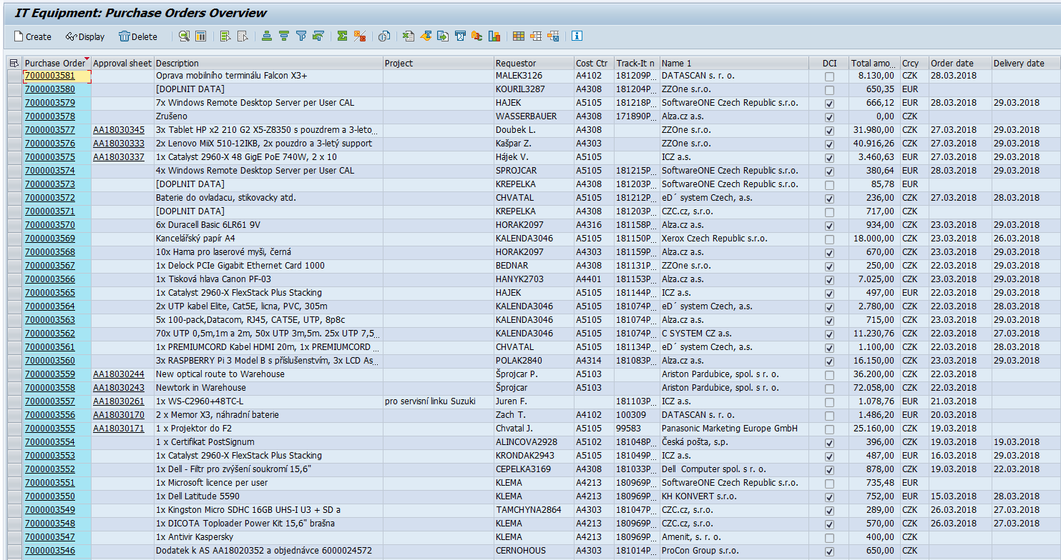

Slide 10
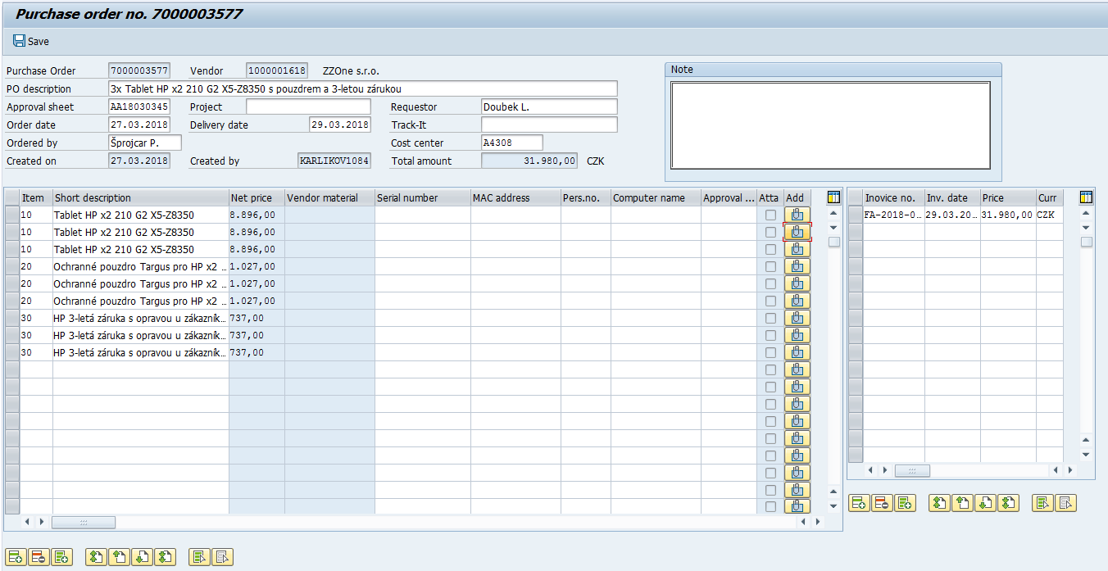

Slide 11
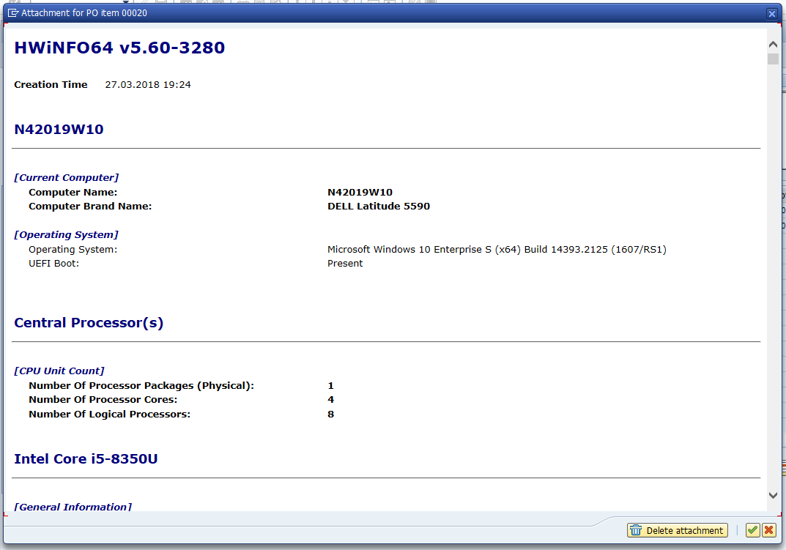

Slide 12
Outgoing quality inspection app
For Outgoing quality department
Used on tablet-class devices
As data source taken multilevel BOM of final product -> list of components
Each component checked either manually or by barcode scanning
Entering some evaluation data for each inspection record
Completely replaced original paper agenda

Slide 13
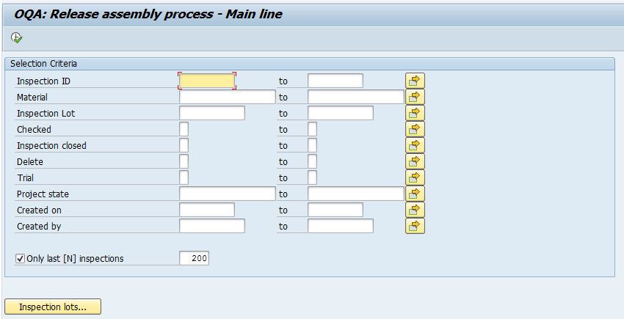

Slide 14
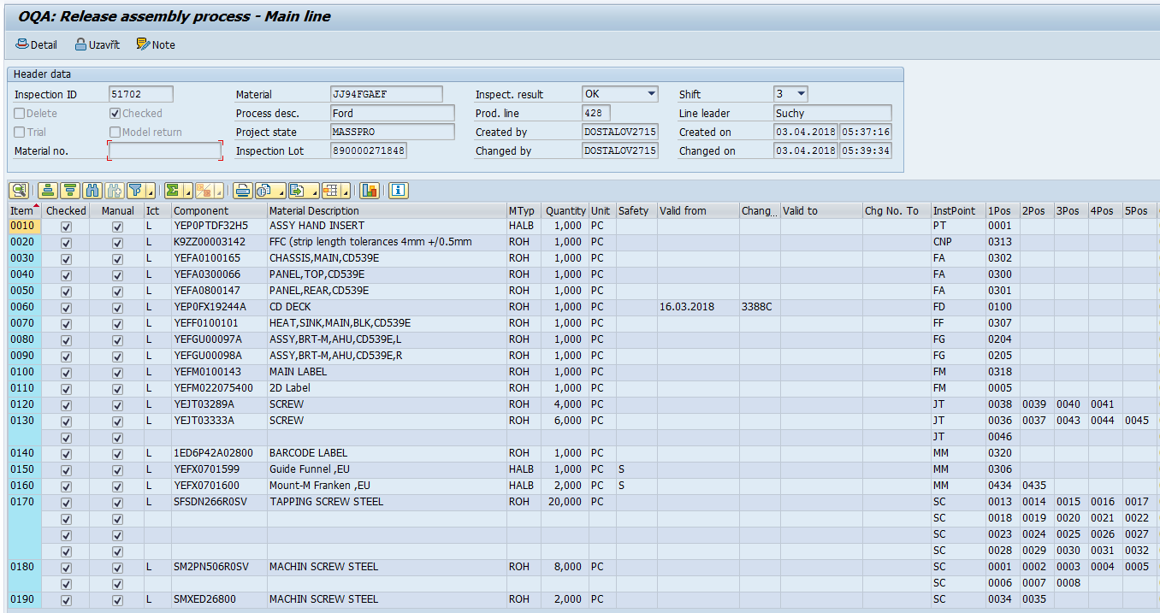

Slide 15
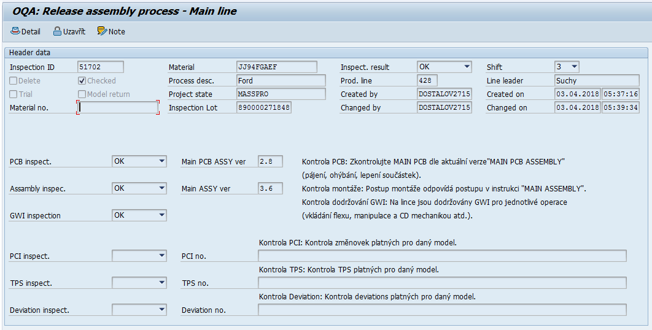

Slide 16
Web app for operational changes of production schedule
For production department (typical user: line leader)
Based on BSP/JavaScript (JQuery)
Running on touch-screen devices – drag & drop supported
Two different views: Mutiple WP view vs. Detailed view for single WP (including tree chart)
Allows to change sorting of work orders and splitting
Only prototype app but fully working

Slide 17
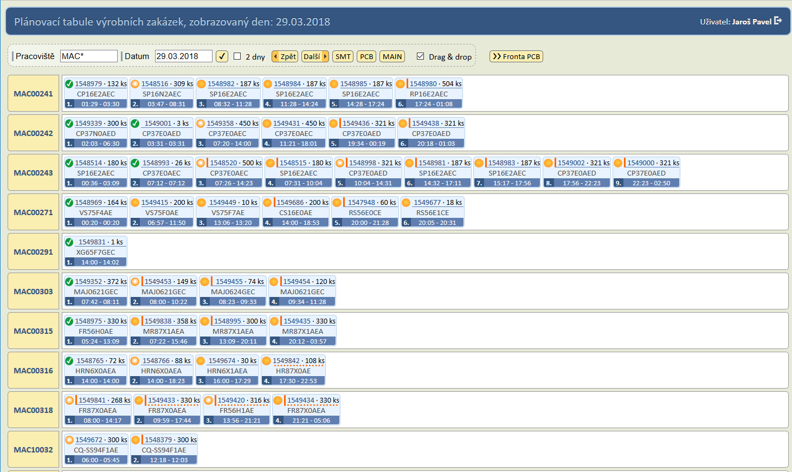

Slide 18
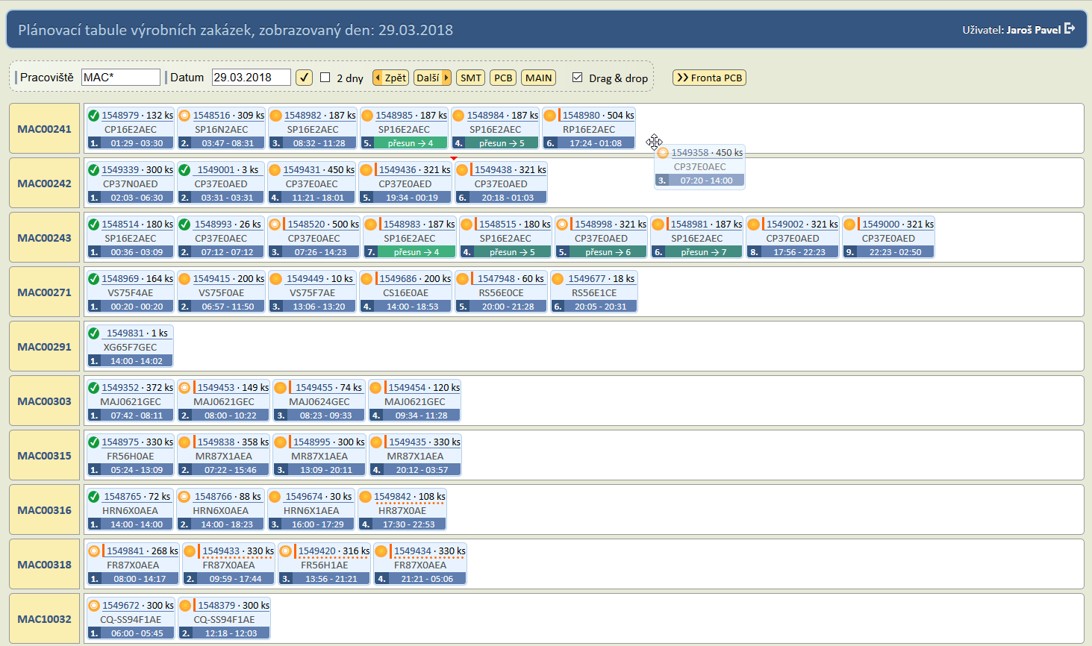

Slide 19
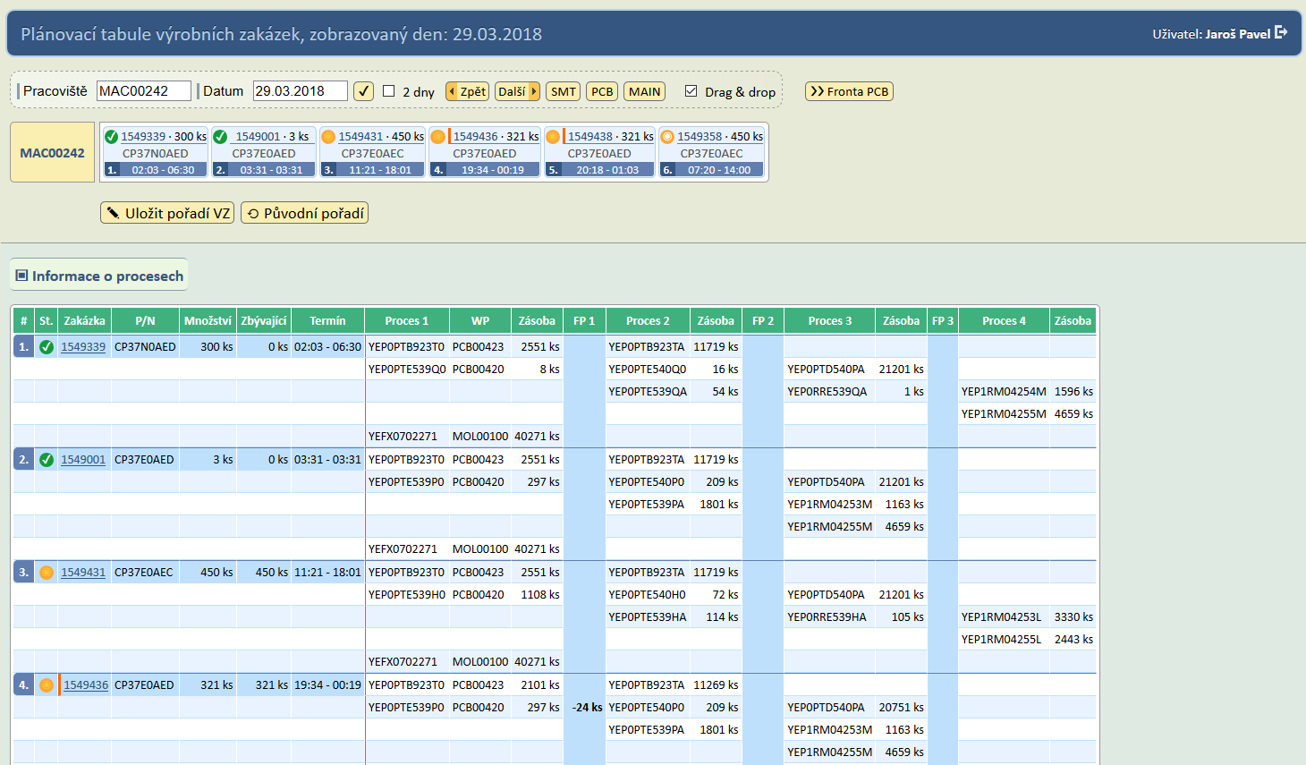

Slide 20
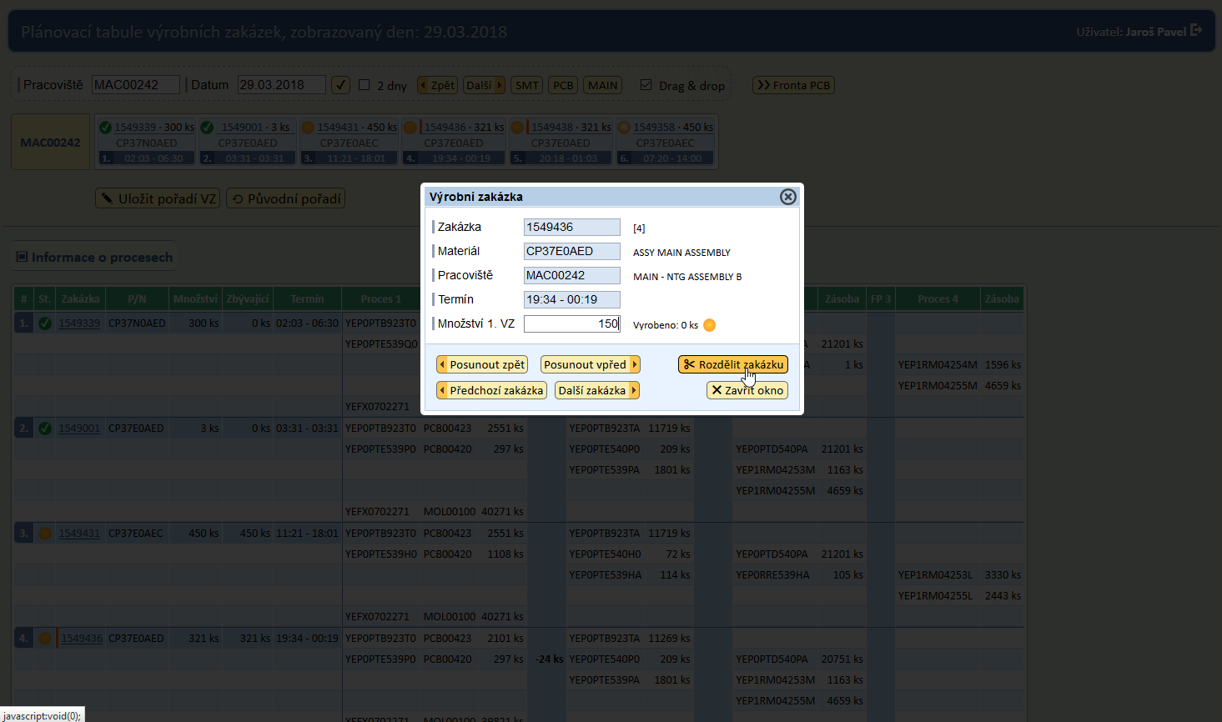

Slide 21
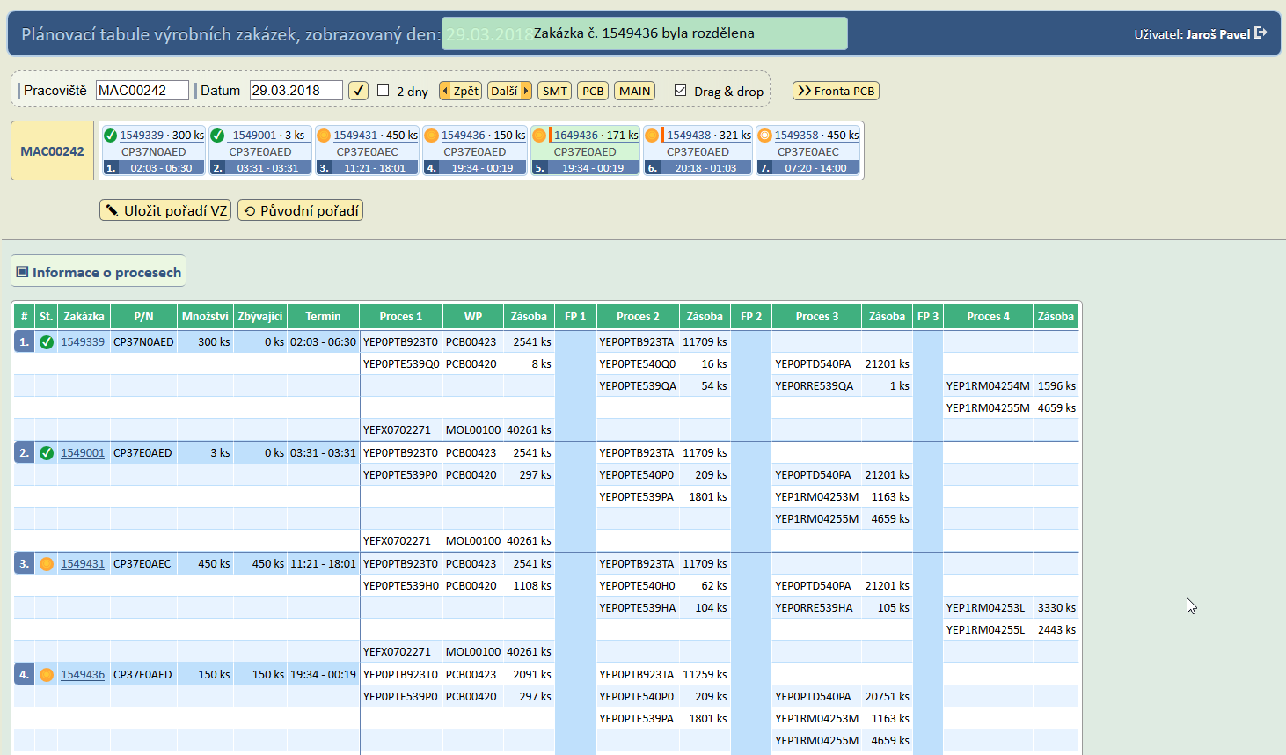

Slide 22
